Slide 1

6390 Final-Attrition at Frito Lay
By-Rashmi Patel

Slide 2

Why it is important to discuss Attrition?
Attrition refers to the employee or staff turnover, but in a broader sense, a calculation of the number of individuals or items that vacate or move out of a larger, collective group over a specified time frame is referred as attrition rate.
Prior to discussion of root causes, what is the outcome if we address attrition?
Showcase Frito-Lay as a great place to work
Employee Retainment (for a longer period)
Employee satisfaction
Reduction in the costs associated with employee turnover
Data contains ~30 variables on employee retention.
Unlikely one variable explains employee attrition
Principal component analysis is used for dimensionality reduction to generalize attrition

Slide 3
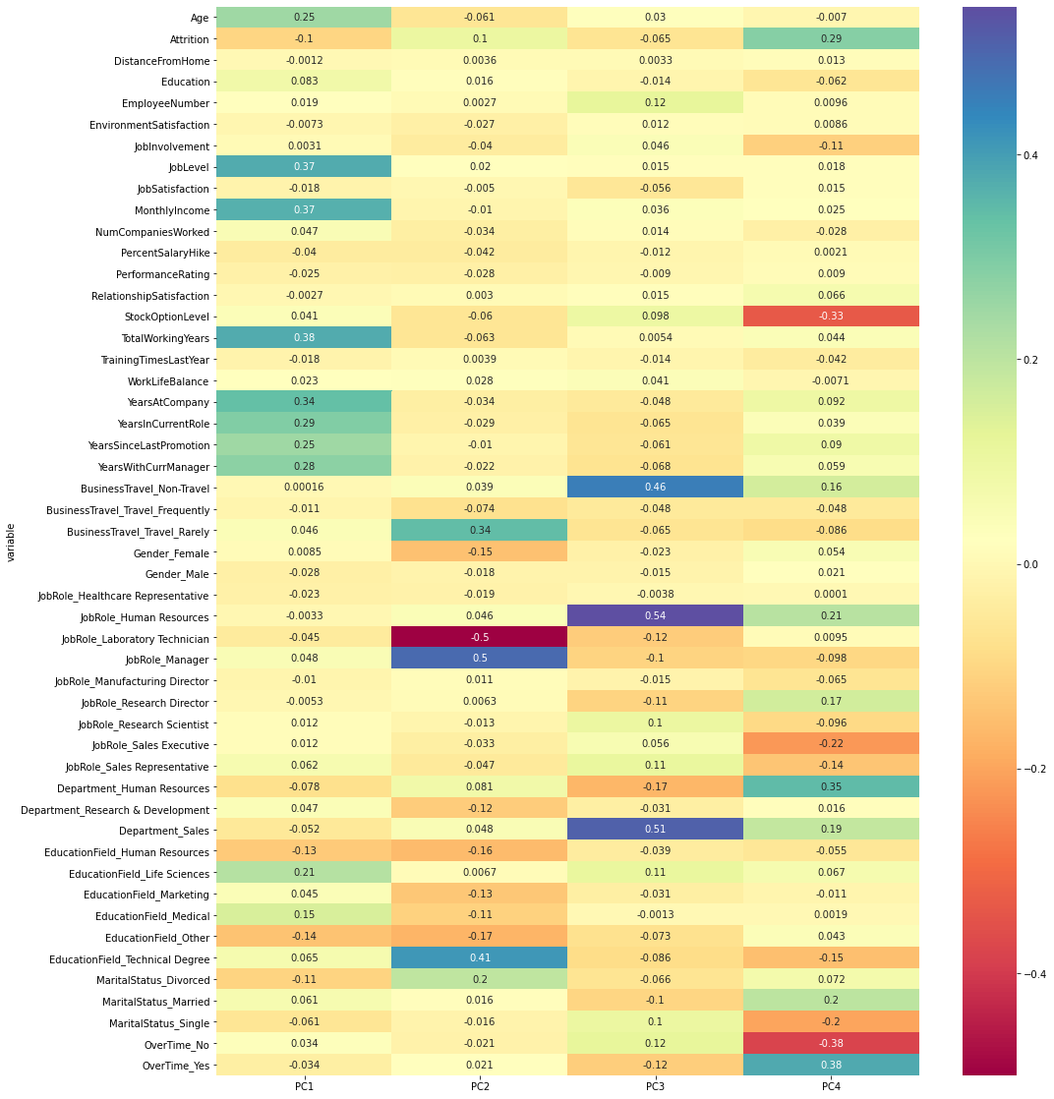
Correlation plot of variables with each principal component
Notes:
## here is the heat map which shows that how the variables are correlated with each principal components which are generated using dimensionality reduction. Lets look how these is related to attrition

Slide 4
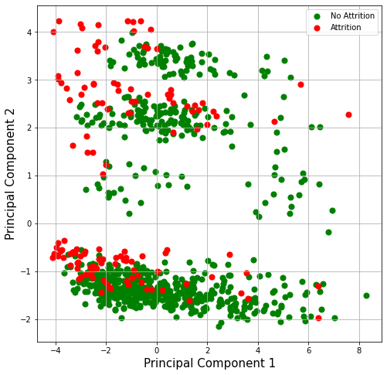
Attrition Visualized
PC1: Associated with total working years, job level, and monthly income. This component is a primary measure of career length and longevity and is a measure of success.
PC2: Associated with employees who are managers, technical degree in education, travel rarely for business and divorced.
Attrition Takeaway: Between PC1 and PC2 we found that job role and marital status play a large role in attrition.
Benefit: Marital status is largely outside of work; simple remedy of more PTO, potentially refocuses noncommitted workforce
Risk: Increased homelife stress will come into work and impact business operations
Notes:
###Interpretation of PC1 and PC2###
The first component is positively correlated with total working years, years at company, job level, monthly income. This suggests the given variables vary together and when one goes down, the others decrease as well. The component could be considered a primary measure of career length and longevity and is a measure of success. #The second component is mostly correlated with other education degree, job role of sales representative, laboratory technician, and females, but in a negative direction. Manager job role, technical degree education, rare business travel and divorced employees are correlated with the second component in the positive direction, which indicates that as other education degree, sales representative, etc. decrease, the technical degree education, manager job role, rare business travel etc. increase. # Looking at the plot we can see that attrition is more seen towards the negative direction of the Principal component1 and 2.
In terms of the first component, we can say that Job level and monthly income points towards attrition more in negative side. The same with technical degree education, rare business travel for the second component.

Slide 5
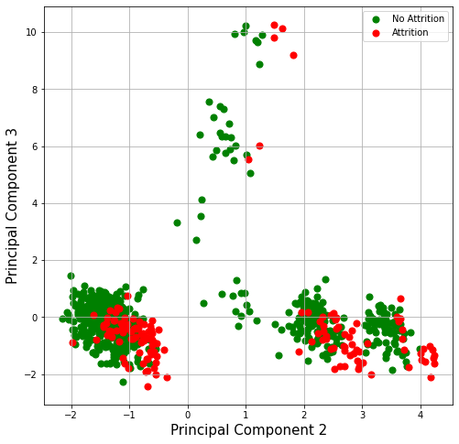
Attrition Visualized
PC3: This component is most related to no business-travel, human resources job role, sales department and single employees.
Attrition Takeaway: Between PC2 and PC3 we can see once again job role and marital status are highly associated with attrition.
Benefit: Salary increases are an expense, but they pale in comparison to onboarding costs
Risk: Low salaries cause attrition, Frito-Lay cannot focus on growth, constant internal struggles
Notes:
###Interpretation of PC3#### #The third component is mostly correlated with sales department, human resources job role, and no business travel, in a positive direction. On the other hand, laboratory technician job role, human resources department , married employees is correlated with PC3 but in a negative direction, suggesting that as sales department, human resources job role, no business travel decrease, married employees, human resources department increase. In terms of third component, we can say that sales department, no business travel leads to attrition in negative side and married employees, human resources department points to few attrition in positive side.

Slide 6
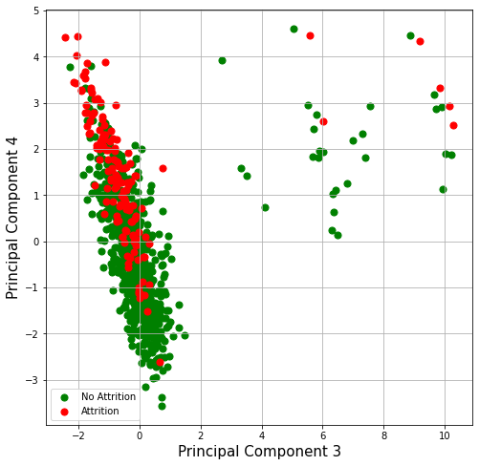
Attrition Visualized
PC4: This component is most related to employees doing overtime, job role of sales executive, research director, human resources, employees who are married, and sales department.
Attrition Takeaway: Between PC3 and PC4 we can see once again job role and marital status are highly associated with attrition.
Benefit: Salary increases are an expense, but they pale in comparison to onboarding costs
Risk: Low salaries cause attrition, Frito-Lay cannot focus on growth, constant internal struggles
Notes:
##Interpretation of PC4##: The fourth component is mostly correlated with employees doing overtime, employees who are married, human resources job role and department in positive direction. Stock option level, sales executive job role, no overtime, single employees are correlated with 4th component but in negative direction suggesting that as the singles employees, sales executive job role decrease, there will be increase in employees doing overtime who are married. Looking at the plot we can say that attrition associated with married employees doing overtime is seen in positive side of fourth component.

Slide 7


Aggregating all variables via dimensionality reduction indicates that marital status and salary hike point towards attrition.
Next Steps:
Frito-Lay will be unable to address growth opportunities and should consider being more generous with paid time off to incentivize employees to strive for more work life balance.
Leadership should also consider raising salaries to address the variable salary hike. Despite the initial costs of increases salaries, conventional wisdom tells us that increases salaries of existing employees instead of bringing on new employees will reduce costs in the long run
As a result of these two actions, existing employees will stay, and Frito-Lay can shift its resources elsewhere to focus on growing sales, increasing footprint, and reducing overhead.
Frito-Lay should focus on reducing sales staff attrition and increase salaries

